Slide 1
ENSE 470 Milestone 1
Jeremy Cross
Iden Ellia
Abdullah Alasmari

Slide 2
Team Commit
Our team members are:
Jeremy
I’m a a 3.5 year software student
Interests: gaming, anime, manga
Iden
I'm a third year software student
Interests: vulnerability research (hacking!!!!!)
Abdullah
I'm a third year software student
Interests: solving nondeterministic and polynomial time problems

Slide 3
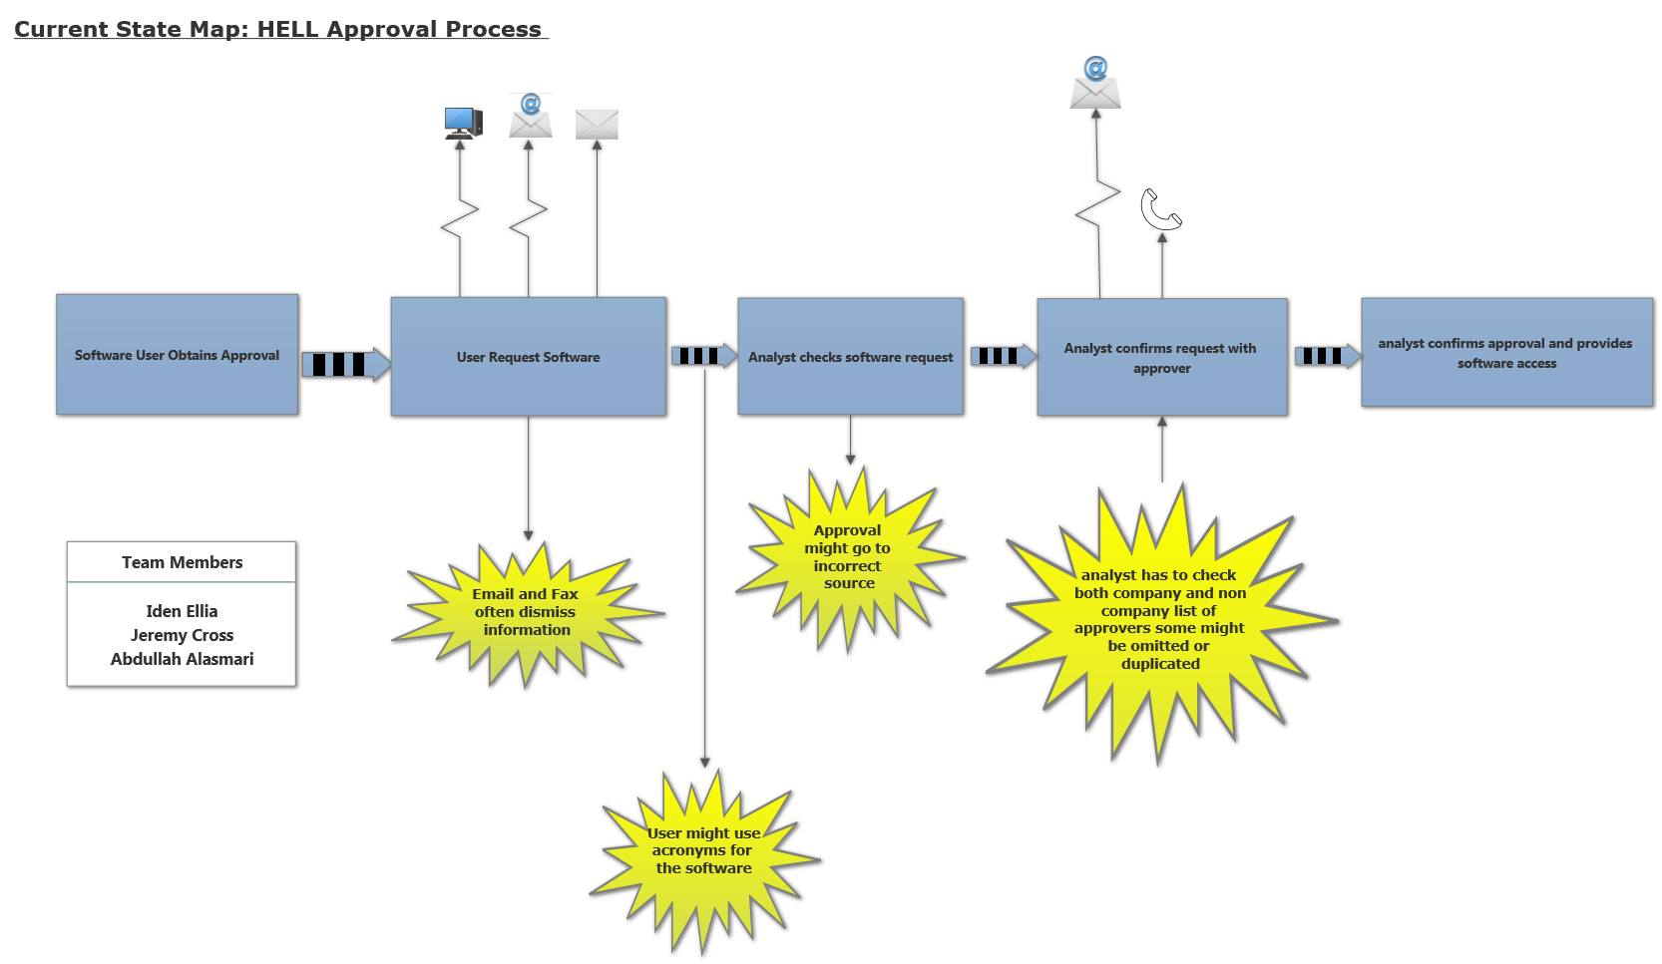
Current State Value Stream Map (VSM)

Slide 4
Group Reflection
How did you feel about this milestone? What did you like about it? What did you dislike?
Its help us break down the problem and understand the individual steps required for the process
What did you learn about yourself as you collaborated and worked through this milestone?
How to remove water marks lolz
How will you use what you have learned going forward?
We will use the information from our current state diagram in this milestone to create our future state diagram for the next milestone.
What “stuff & things” related to this milestone would you want help with?
Is there better software for creating state diagrams?

